Slide 1
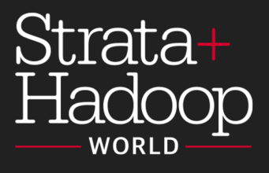
Using R for Scalable Data Analytics: Single Machines to Spark Clusters
John-Mark Agosta, Hang Zhang, Robert Horton, Mario Inchiosa, Srini Kumar, Katherine Zhao, Vanja Paunic and Debraj GuhaThakurta
Microsoft
Acknowledgement: Ali-Kazim Zaidi
TUTORIAL MATERIAL & SLIDES: tinyurl.com/Strata2017R
ROOM: LL21 C/D, San Jose Convention Center
TIME: 9:00am - 12:30pm, March 14th, 2017
1
Notes:
Good morning everyone. Welcome to the hands-on tutorial session. My name is Katherine Zhao. I’m a Data Scientist at Microsoft and working on E2E scalable analytics solutions with Microsoft technologies. In the next 3.3 hours,
my colleagues and I will walk you through the Using R for Scalable Data Analytics: single machines to Spark clusters.
Before we get started, the tutorial material and slides available at... And you can also find the URL from the paper clip you got when you walked in. We will use that material later in the session.

Slide 2
Tutorial Outline
Introduction - scaling your R scripts [~15 mins]
Scaling R on Spark: Hands-on tutorials [~140 mins]
Open source R on Spark [~70 mins]
Microsoft R server [~70 mins]
DNN on R (image recognition) [~10 mins]
Other options for scaling R [~10 mins, time permitting]
Q&A [15 mins]
15 min break after ~ 1 ½ hrs
2
Notes:
In this tutorial, we will cover an introduction of scaling your R scripts. Hands-on tutorials of an E2E scalable data analysis in R. Some practical examples and case studies. The remaining time, we will leave it to the Q&A.

Slide 3
Introduction - Scaling your R scripts
Katherine Zhao
3

Slide 4
Introduction
What is R?
What limits the scalability of R scripts?
What functions and techniques can be used to overcome those limits?
4
Notes:
In the introduction, we will be answering these 4 questions.

Slide 5

What is
Language
Platform
The most popular statistical programming language
A data visualization tool
Open source
Community
2.5+M users
Taught in most universities
New and recent grad’s use it
Thriving user groups worldwide
Ecosystem
10,000+ contributed packages
Rich application & platform integration
5
Notes:
Let me ask a quick question here, how many of you used R before?
So, what’s R? R is the most popular statistical programming language. It’s also used as a data visualization tool. R is a part of the open source community.
In the community, there are over 2.5 MM R users. Most universities are teaching R in the classrooms and students are using R for their projects. R has thrived its user groups worldwide.
With the rapid growth, right now, there are over 10000 R packages and R has integration with numerous application & platforms.

Slide 6
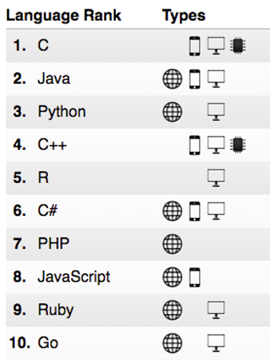
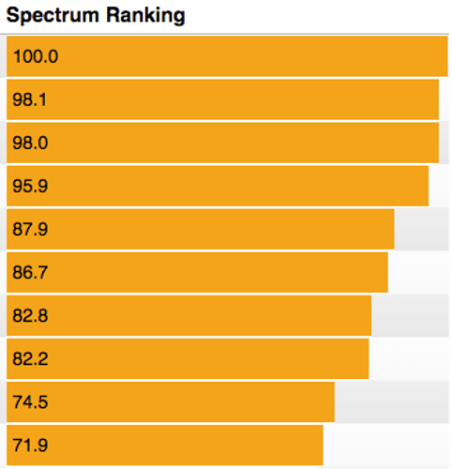
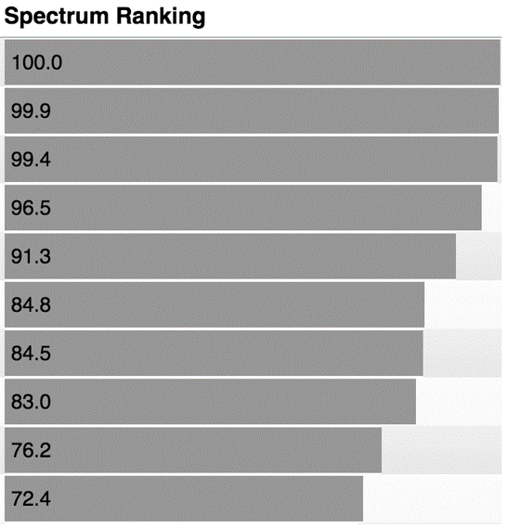
R ranks #5 in IEEE Spectrum July 2016
2016
2015
6
Notes:
In the most recent IEEE Spectrum’s ranking of the top 10 popular programming languages, R has followed its momentum from previous years and moved up to the top 5. So the top 5 programming language are…

Slide 7
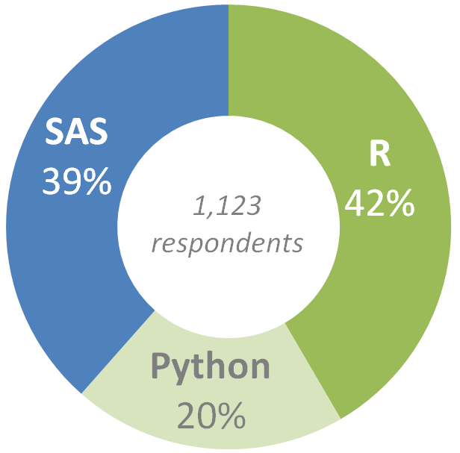
Preferred language by Analytics Pros
Which do you prefer to use: SAS, R, or Python?
Source: SAS, R or Python Survey 2016, by Burtch Works
7
Notes:
Another interesting survey by Burth Works also shows the popularity of R. For over 1000 respondents, 42% of them prefer to use R over SAS or Python for their analytics.

Slide 8
Common R use cases
Vertical | Sales & Marketing | Finance & Risk | Customer & Channel | Operations & Workforce
Retail | Demand Forecasting Loyalty Programs Cross-sell & Upsell Customer Acquisition | Fraud Detection Pricing Strategy | Personalization Lifetime Customer Value Product Segmentation | Store Location Demographics Supply Chain Management Inventory Management
Financial Services | Customer Churn Loyalty Programs Cross-sell & Upsell Customer Acquisition | Fraud Detection Risk& Compliance Loan Defaults | Personalization Lifetime Customer Value | Call Center Optimization Pay for Performance
Healthcare | Marketing Mix Optimization Patient Acquisition | Fraud Detection Bill Collection | Population Health Patient Demographics | Operational Efficiency Pay for Performance
Manufacturing | Demand Forecasting Marketing mix Optimization | Pricing Strategy Perf Risk Management | Supply Chain Optimization Personalization | Remote Monitoring Predictive Maintenance Asset Management
8
Notes:
R has been used across different verticals in academia and industry, such as Retail, Financial Services, Healthcare, and Manufacturing. Some of the common use cases are demand forecasting, customer churn, fraud detection and etc.

Slide 9
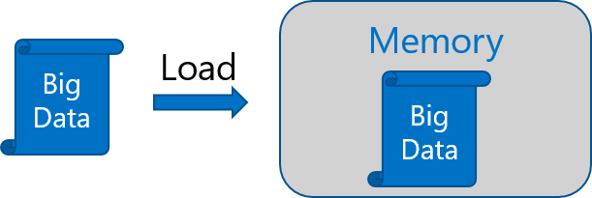
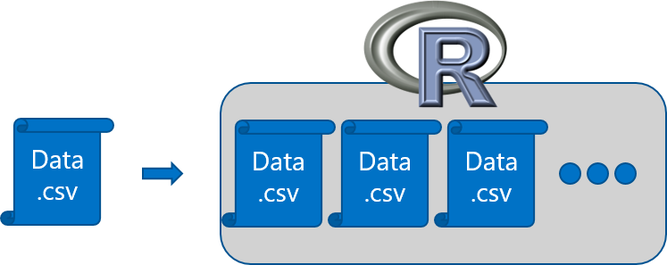
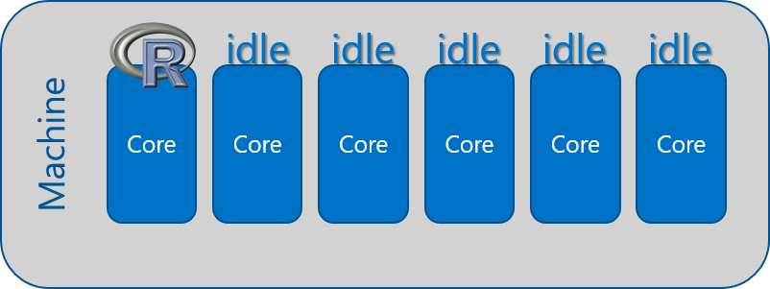
R adoption is on a Tear
In-Memory Operation
Expensive Data Movement
& Duplication
Lack of Parallelism
9
Notes:
Although R is very popular in practice, we often heard some challenges raised in the R community in terms of its scalability.
The first challenge is In-memory operation: R behaves to load all objects into the memory that could easily cause the out-of-memory problem when handling big data.
R also has Expensive data movement and duplication: R intends to copy an object, not just referring to it in an assignment. This could also blow up the memory.
Lastly, Lack of parallelism: R, by default, is a one-threaded language, where it executes on only one core in a multi-core machine.

Slide 10



Open source R is not enterprise class
Inadequacy of Community Support
Lack of Guaranteed Support Timeliness
No SLAs or Support Models
10
Notes:
Open source R is not an enterprise class either because of its inadequacy of community support, lack of guaranteed support timeliness and no SLAs or support models.

Slide 11
Couple of scalable R solutions
R packages with for distributed computing [Hands-on]
SparkR
sparklyr
RevoScaleR (Microsoft R Server)
h2o
and more!
R packages with big data support on single machines
The bigmemory project
ff and related packages
foreach with doParallel, doSNOW, doNWS backends
11
Notes:
But there are many scalable R solutions in the community and out on the market.
We can choose some R packages with big data support on single machine. such as the work from the bigmemory project, ff and its related packages and foreach with variouds backends.
We can also scale from single machines to distributed computing on clusters using SparkR, sparklyr, revoscaleR and other packages.
In the upcoming slides, I’m going to talk through those solutions with details. I personally use some packages more than the others, so please feel free to add in anything if I miss it. We will also use the distributed computing solutions in the hands-on session.

Slide 12
Hands-on Tutorials Section I: SparkR and sparklyr
Katherine Zhao
Debraj GuhaThakurta
Srini Kumar
Hang Zhang
Acknowledgement: Ali-Kazim Zaidi
12

Slide 13
Open Source Packages for Distributed computing using R on Spark
Brief intro to Spark, its APIs and OS R packages
13

Slide 14
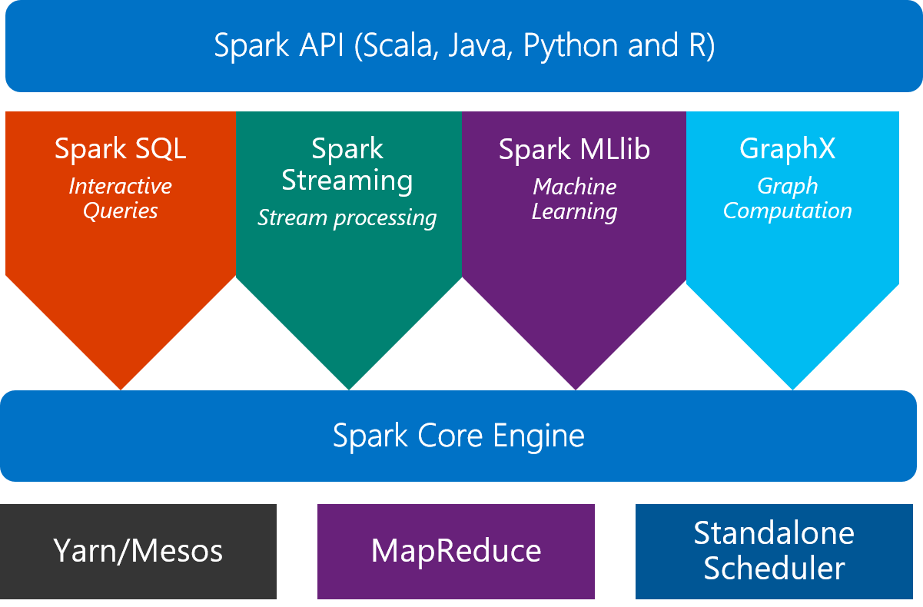
Scale on Spark clusters
What is Spark?
An unified, open source, parallel, data processing framework for Big Data Analytics
14
Notes:
As we have gone through how to scale R scripts on single machines, let’s now talk about other approaches can bring us from single machines to distributed computing.
Scale on Spark clusters is one of those approaches and is our focus today.
How many of you used Spark before?
Before we go any further, what is Spark? Spark is an unified, open source, parallel, data processing framework for big data analytics. Spark core engine can run on difference resource management technologies, such as Yarn, MapReduce, or its standalone scheduler. On top of the core engine, Spark unifies interactive queries, streaming analytics, machine learning, and graph computation. Spark also provides APIs for convenient data access through developer applications like Scala, Java, Python and R.

Slide 15

SparkR 2.0: a Spark API
An R package provides a light-weight frontend to use Apache Spark from R and allows data scientists to analyze large datasets.
SparkDataFrame is distributed collection of data organized into named columns.
SparkR can create SparkDataFrames from local R data frames, csv, json and parquet files.
With Hive support, it can also access tables from Hive MetaStore.
Pre-configured on Spark clusters in HDInsight.
15
Notes:
SparkR is an R packages provides a light-weight frontend to use Apache Spark from R and allows data scientists to analyze large datasets.
Spark DataFrame is conceptually equivalent to a table in a relational database or a data frame in R. If you’re familiar with Spark RDD, then you can think DataFrame as RDD with schema.

Slide 16
Data processing and modeling with SparkR
Supports functions for structured data processing:
Selections: select(), filter()
Grouping, Aggregations: summarize(), arrange()
Running local R functions distributed: spark.lapply()
Applying UDFs on each partition/group of a SparkDataFrame: dapply(), dapplyCollect(), gapply(), gapplyCollect()
Uses MLlib to train models and allows model persistence.
Generalized Linear Model
Accelerated Failure Time (AFT) Survival Regression
Naive Bayes
KMeans
Logistic Regression
Isotonic Regression
Latent Dirichlet Allocation
Multiplayer Perceptron Classification
Gradient Boosted Tree
Random Forest
Alternating Least Squares (ALS) Matrix Factorization
Kolmogorov-Smirnov Test
16
Notes:
SparkR supports functions for structured data processing, including data selection and aggregation. In SparkR 2.0, it also allows applying UDFs on each partition of a SparkDF.
For machine learning, it uses Spark machine learning library Mllib to fit GLM models
More algorithms, such as survival regression, NB, Kmeans, and model persistence are available in SparkR 2.0.

Slide 17
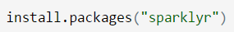
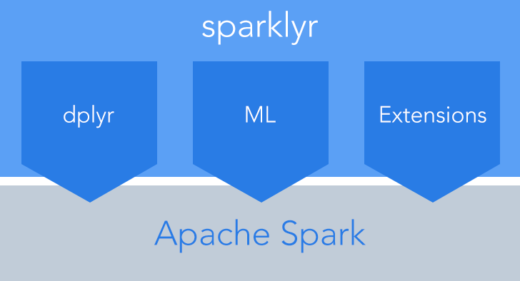
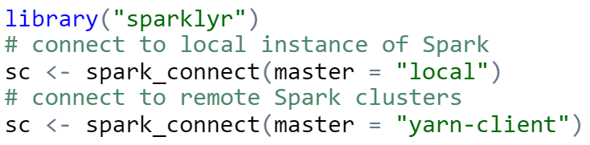
sparklyr: R interface for Apache Spark
Easy installation from CRAN
Connect to both local instances of Spark and remote Spark clusters
Loads data into SparkDataFrame from: local R data frames, Hive tables, CSV, JSON, and Parquet files.
Source: http://spark.rstudio.com/
17
Notes:
Sparklyr is another R interface for Apache Spark. On top of Spark engine, it contains three main components: dplyr, ML and extensions that call full Spark API.
It can easily install using devtools.
It connects to both local instances of Spark and remote Spark clusters.
Like SparkR, it also loads data from different data sources into Spark DataFrames.

Slide 18
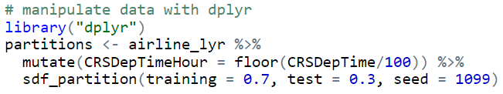
dplyr and ML in sparklyr
Provides a complete dplyr backend for data manipulation, analysis and visualization
%>%
Includes 3 family of functions for machine learning pipeline
ml_*: Machine learning algorithms for analyzing data provided by the spark.ml package.
K-Means, GLM, LR, Survival Regression, DT, RF, GBT, PCA, Naive-Bayes, Multilayer Perceptron, LDA
ft_*: Feature transformers for manipulating individual features.
sdf_*: Functions for manipulating SparkDataFrames.
18
Notes:
Sparklyr provides a complete dplyr backend for data manipulation, analysis and visualization. If you’re not familiar with dplyr, it simply builds data manipulation pipelines through the pip operators. %>%. We will also use this package in the hands-on session later.
Sparklyr includes 3 family of functions for its machine learning pipeline.
ml functions provide machine learning algorithms such as Kmeans, GLM, LR, Survival Regression, Multilayer Perceptron and etc.
Ft functions perform data transformation on individual features.
And sdf functions are used for manipulating SparkDFs.

Slide 19
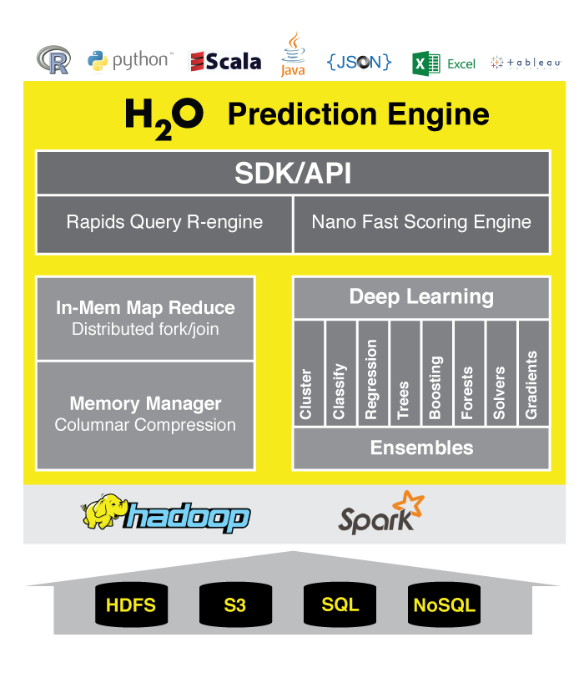
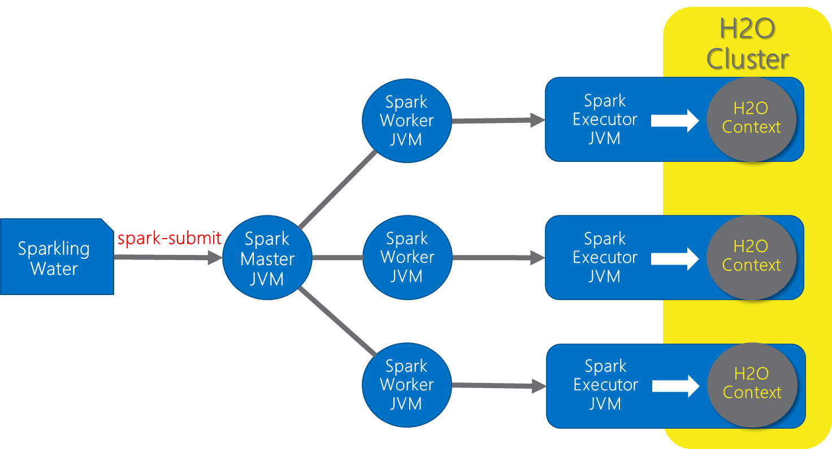
h2o: prediction engine in R
Optimized for “in memory” processing of distributed, parallel machine learning algorithms on clusters.
Sparkling Water = h2o + Spark
Data manipulation and modeling: R functions + h2o pre-fixed functions.
Transformations: h2o.group_by(), h2o.impute()
Statistics: h2o.summary(), h2o.quantile(), h2o.mean()
Algorithms: h2o.glm(), h2o.naiveBayes(), h2o.deeplearning(), h2o.kmeans()
http://www.h2o.ai/product/
19
Notes:
Sparkling Water is designed to be executed as a regular Spark application. It provides a way to initialize H2O services on each node in the Spark cluster and access data stored in data structures of Spark and H2O.
Since Sparkling Water is designed as Spark application, it is launched inside a Spark executor, which is created after application submission. At this point, H2O starts services, including distributed KV store and memory manager, and orchestrates them into a cloud. The topology of the created cloud matches the topology of the underlying Spark cluster exactly.
Sparkling Water provides transparent integration for the H2O engine and its machine learning algorithms into the Spark platform, enabling:
use of H2O algorithms in Spark workflow
transformation between H2O and Spark data structures
use of Spark RDDs as input for H2O algorithms
transparent execution of Sparkling Water applications on top of Spark

Slide 20
Compute Platforms for Hands-on & Demos
+
General analytical flow
20

Slide 21






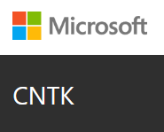


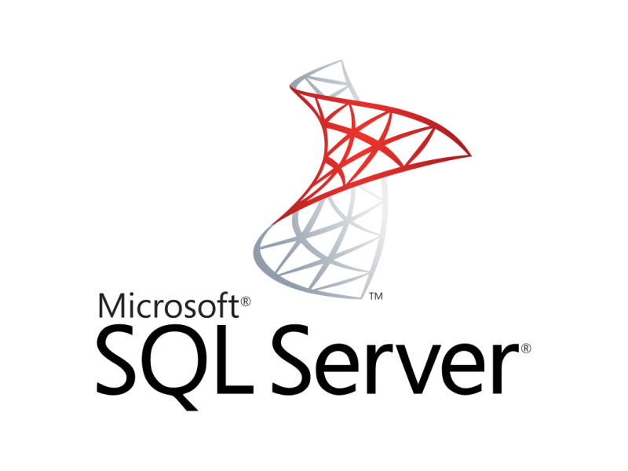



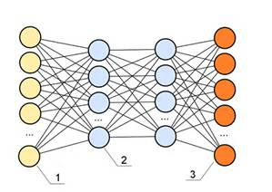





Single node Azure Linux DSVM w/ Spark (for Hands-On)
Data-science virtual machine
Vowpal Wabbit
xgboost
Rattle
Spark 2.0.2
HDFS (local)
Yarn
Developer edition
CNTK
http://aka.ms/dsvm
21
Notes:
You can easily provision Spark clusters in Azure HDInsight and Spark 2.0.2 is pre-installed and configured.
Spark clusters in HDInsight provides a common execution model for tasks like ETL, batch/interactive queries, real-time streaming, machine learning, and graph processing. And data is stored in Azure Blob Storage, which is an implementation of HDFS.

Slide 22
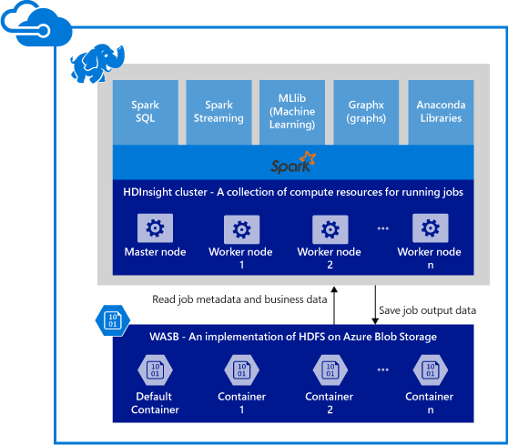
Spark clusters in Azure HDInsight
Provisions Azure compute resources with Spark 2.0.2 installed and configured.
Supports multiple versions (e.g. Spark 1.6).
Stores data in Azure Blob storage (WASB), Azure Data Lake Store or Local HDFS.
22
Notes:
You can easily provision Spark clusters in Azure HDInsight and Spark 2.0.2 is pre-installed and configured.
Spark clusters in HDInsight provides a common execution model for tasks like ETL, batch/interactive queries, real-time streaming, machine learning, and graph processing. And data is stored in Azure Blob Storage, which is an implementation of HDFS.

Slide 23
General analytical workflow in Spark
Ingest into Spark DF
Wrangling and cleanup (Spark SQL, dplyr)
Creation of ML models in Spark
+
Model evaluation
Exploration and visualization
(for visualization, sampled data may need to be converted to R dataframe)
Transfor-mation and Featurization
(in Spark SQL or featurization functions)
Save models for deployment
Spark dataframes used multiple times in the workflow should be cached in memory
23

Slide 24
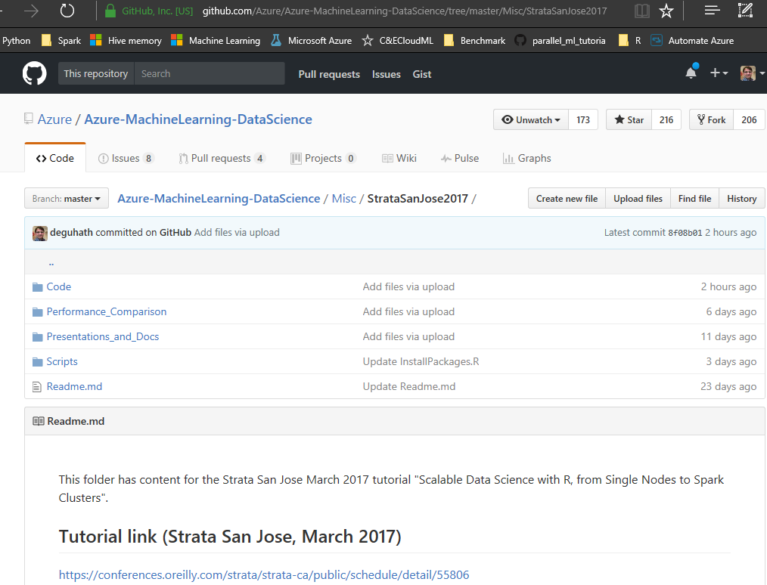
GitHub repository for all code and scripts
tinyurl.com/Strata2017R
24

Slide 25


Model deployment using R-server operationalization services
Easy Consumption
Explore and consume services in R directly
Data Scientist
Easy Deployment
Turn R into web services in one line of code
Microsoft R Client
(mrsdeploy package)
Data Scientist
Services / Sessions
getService
Microsoft R Client
(mrsdeploy package)
publishService
Microsoft R Server
configured for
operationalizing R analytics
REST API calls
Easy Setup
In-cloud or on-prem
Adding nodes to scale
High availability & load balancing
Remote execution server
Apps
Easy Integration
Swagger-based APIs: easy to consume with any programming language
Developer
25

Slide 26

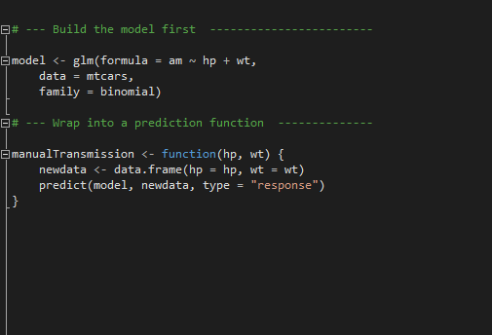
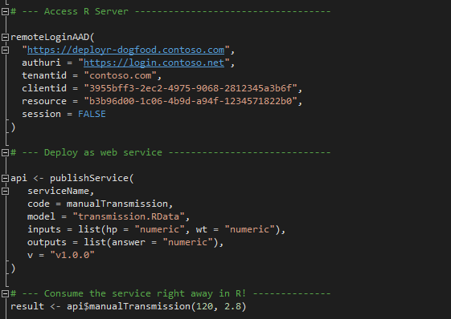
Deployment Turn R into Web Services easily; and consume them in R
Build the model first
Deploy as a web service instantly
Package: mrsdeploy
https://msdn.microsoft.com/en-us/microsoft-r/operationalize/configuration-initial
https://msdn.microsoft.com/en-us/microsoft-r/operationalize/admin-utility
26
Notes:
If a version is not specified, a temp guid endpoint is created – this is mainly for development phase and sharing among team members privately.

Slide 27
10 min break
27

Slide 28
Hands-on Tutorials Section II: Microsoft R Server & RevoScaleR
Katherine Zhao
Mario Inchiosa
Robert Horton
Vanja Paunic
John-Mark Agosta
28

Slide 29
Microsoft R Server & RevoScaleR
29

Slide 30
R Server 9.0: scale-out R, Enterprise Class!
100% compatible with open source R
Any code/package that works today with R will work in R Server.
Ability to parallelize any R function
Ideal for parameter sweeps, simulation, scoring.
Wide range of scalable and distributed rx pre-fixed functions in RevoScaleR package.
Transformations: rxDataStep()
Statistics: rxSummary(), rxQuantile(), rxChiSquaredTest(), rxCrossTabs()…
Algorithms: rxLinMod(), rxLogit(), rxKmeans(), rxBTrees(), rxDForest()…
Parallelism: rxSetComputeContext()
30
Notes:
Lastly, Microsoft R server, AKA, MRS, can also scale out R and it’s truly Enterprise ready.
It’s 100% compatible with open source R, which means any code/package that works today with R will directly work in R server.
It has the ability to parallelize any R function, which is ideal for parameter sweeping, simulation and scoring.
MRS has a wide range of scalable and distributed “rx” pre-fixed functions. Such as… You will use some of those functions later in the hands-on.
In the next slides, you will see a full set of parallelized and distributed analytics provided by R server.

Slide 31




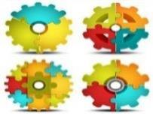





Parallelized & Distributed Analytics
ETL
Statistical Tests
Machine Learning
Data import – Delimited, Fixed, SAS, SPSS, OBDC
Variable creation & transformation
Recode variables
Factor variables
Missing value handling
Sort, Merge, Split
Aggregate by category (means, sums)
Chi Square Test
Kendall Rank Correlation
Fisher’s Exact Test
Student’s t-Test
Decision Trees
Decision Forests
Gradient Boosted Decision Trees
Naïve Bayes
Predictive Statistics
Clustering
Sum of Squares (cross product matrix for set variables)
Multiple Linear Regression
Generalized Linear Models (GLM) exponential family distributions: binomial, Gaussian, inverse Gaussian, Poisson, Tweedie. Standard link functions: cauchit, identity, log, logit, probit. User defined distributions & link functions.
Covariance & Correlation Matrices
Logistic Regression
Predictions/scoring for models
Residuals for all models
K-Means
Descriptive Statistics
Sampling
Min / Max, Mean, Median (approx.)
Quantiles (approx.)
Standard Deviation
Variance
Correlation
Covariance
Sum of Squares (cross product matrix for set variables)
Pairwise Cross tabs
Risk Ratio & Odds Ratio
Cross-Tabulation of Data (standard tables & long form)
Marginal Summaries of Cross Tabulations
Subsample (observations & variables)
Random Sampling
Simulation
Simulation (e.g. Monte Carlo)
Parallel Random Number Generation
Custom Parallelization
Variable Selection
rxDataStep
rxExec
PEMA-R API
Stepwise Regression
31
Notes:
R server works on E2E data processing, analytics, and modeling. It provides the functionalities for ETL, statistics, ML, simulation and custom parallelization.

Slide 32
Portable across multiple platforms
Windows
Linux
HDInsight
Cloud
Hortonworks
Cloudera
MapR
Hadoop & Spark
R Server Technology
R Server portfolio
EDW
SQL Server 2016
Teradata Database
R+CRAN
Microsoft R Client
Operationalization
DistributedR
RDBMS
SQL Server 2016 EE
SQL Server 2016 SE
ConnectR
Desktops & Servers
Windows
Linux (Ubuntu, SUSE, RedHat)
ScaleR
high-speed and direct connectors to HDFS, Teradata, SAS and etc.
provides fully-parallelized analytics
includes distributed computing framework and cross-platform portability
“mrsdeploy” establishes remote execution and publishes & manages web services
32
Notes:
Add pop-out box for each components in MRS.
R server is a set of technologies that is portable across multiple platforms.
There are four key components within R server.
ScaleR: as we talked earlier, it provides fully-parallelized analytics.
ConnectR: has high-speed and direct connectors to various data sources, such as HDFS, Teradata, SAS and etc.
DistributedR: includes distributed computing framework and delivers cross-platform portability.
Operationalization: mrsdeploy package establishes remote execution from console and publishes and manages web services.
In terms of the portability, MRS works in Cloud, Hadoop & Spark clusters, Data Warehouse, Desktops and Servers.

Slide 33
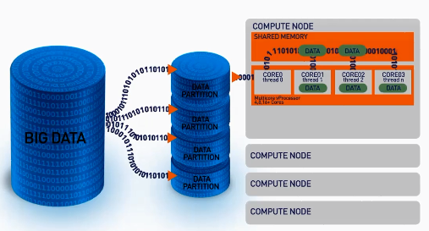
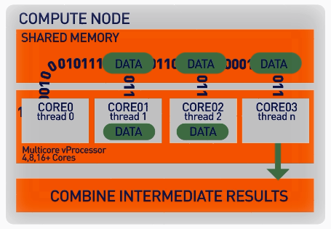
ScaleR: parallel + Big Data
Our ScaleR algorithms work inside multiple cores / nodes in parallel at high speed
Stream data into blocks from sources: Hive tables, CSV, Parquet, XDF, ODBC and SQL Server.
Interim results are collected and combined analytically to produce the output on the entire data set
XDF file format is optimised to work with the ScaleR library and significantly speeds up iterative algorithm processing.
33
Notes:
In order to scale, let’s take a look of how MRS is handling the big data. As the big data comes in, MRS partitions the data into different chunks. Then the data will be sent to different cores on the compute node for the computation. Inside the compute node, the ScaleR algorithms work in parallel at high speed. And interim results are collected and combined analytically to produce output on the entire data set.
XDF file is a new data format that can significantly speed up iterative algorithm processing.

Slide 34
Write Once - Deploy Anywhere
ScaleR models can be deployed from a server or edge node to run in Spark/Hadoop without any functional R model re-coding.
Local Parallel processing - Linux or Windows
In – Spark/Hadoop
### SETUP LOCAL ENVIRONMENT VARIABLES ###
myLocalCC <- “localpar”
### LOCAL COMPUTE CONTEXT ###
rxSetComputeContext(myLocalCC)
### CREATE LINUX, DIRECTORY AND FILE OBJECTS ###
linuxFS <- RxNativeFileSystem( )
AirlineDataSet <- RxXdfData(“airline_20MM.xdf”,
fileSystem = linuxFS)
### SETUP SPARK/HADOOP ENVIRONMENT VARIABLES ###
mySparkCC <- RxSpark() myHadoopCC <- RxHadoopMR()
### HADOOP COMPUTE CONTEXT ###
rxSetComputeContext(mySparkCC) rxSetComputeContext(myHadoopCC)
### CREATE HDFS, DIRECTORY AND FILE OBJECTS ###
hdfsFS <- RxHdfsFileSystem()
AirlineDataSet <- RxXdfData(“airline_20MM.xdf”, fileSystem = hdfsFS)
Compute context R script - sets where the model will run
Functional model R script – does not need to change to run in Spark
### ANALYTICAL PROCESSING ###
### Statistical Summary of the data
rxSummary( ~ ArrDelay + DayOfWeek, data = AirlineDataSet, reportProgress = 1)
### CrossTab the data
rxCrossTabs(ArrDelay ~ DayOfWeek, data = AirlineDataSet, means = T)
### Linear model and plot
hdfsXdfArrLateLinMod <- rxLinMod(ArrDelay ~ DayOfWeek + CRSDepTime, data = AirlineDataSet)
plot(hdfsXdfArrLateLinMod$coefficients)
34
Notes:
Another important concept of MRS that I wanna talk about is Write once and deploy anywhere. This means ScaleR models can be deployed in Spark or Hadoop clusters without recoding any functional R model.
Let’s see an example here.
Compute context in scripts can be set where the model will run. If we run a model locally in Linux or windows machines, we can set compute context as local parallel and file system as local directory. If we deploy it in Spark/Hadoop, the only things we need to change are the compute context to Spark or Hadoop MapReduce, and HDFS file system.
As you can see, the functional scripts for statistical analysis, modeling and visualization will remain the same no matter it’s running on local machines or clusters.

Slide 35
Base and scalable approaches comparison
Approach | Scalability | Spark | Hadoop | SQL Server | Teradata | Support
CRAN R1 | Single machines |  |  |  |  | Community
SparkR | Single + Distributed computing | X |  |  |  | Community
sparklyr | Single + Distributed computing | X |  |  |  | Community
h2o | Single + Distributed computing | X | X |  |  | Community
RevoScaleR | Single + Distributed computing | X | X | X | X | Enterprise
CRAN R indicates no additional R packages installed
35
Notes:
As we talked about different approaches to scale our R scripts, let’s see a comparison between the base the scalable approaches.

Slide 36
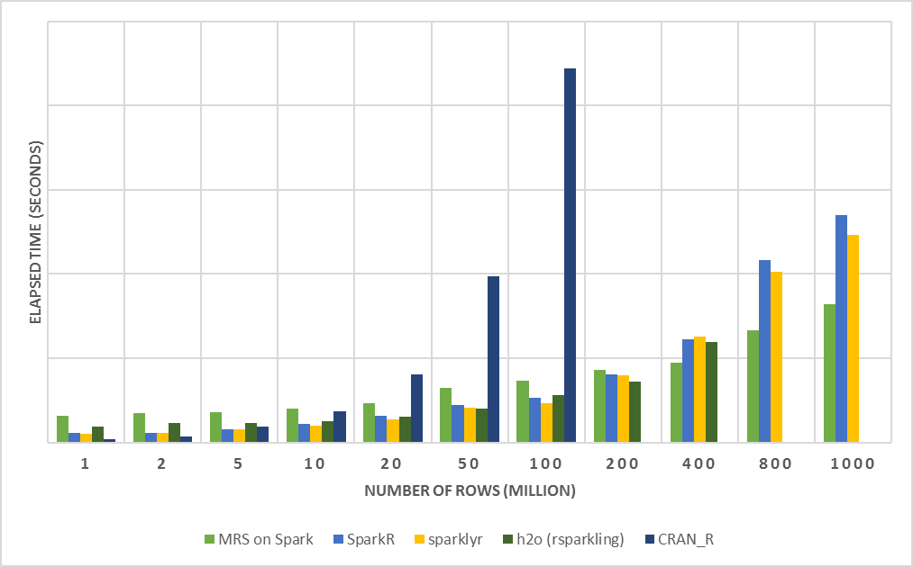
R Server on Spark - faster and more scalable
E2E Process:
Load Data from .csv
Transform Features
Split Data: Train + Test
Fit Model: Logistic Regression (no regularization)
Predict and Write Outputs
Configuration:
1 Edge Node: 16 cores, 112GB
4 Worker Nodes: 16 cores, 112GB
Dataset: Duplicated Airlines data (.csv)
Number of columns: 26
36
Notes:
With that, you’re probably wondering how fast and scalable that the those approaches could be. Let me show you an example of execution time of running a logistic regression model from end to end using CRAN R, MRS on Spark, SparkR, sparklyr and rsparkling. This is not a benchmarking, but it shows R server on Spark, in the light green line, is faster and more scalable. As we can see in this plot, CRAN R is not able to handle the process when we increase the number of rows to 50 million on this airline dataset, but MRS on Spark can handle much more data. Also, MRS on Spark has the smallest execution time especially when the data size increases.

Slide 37
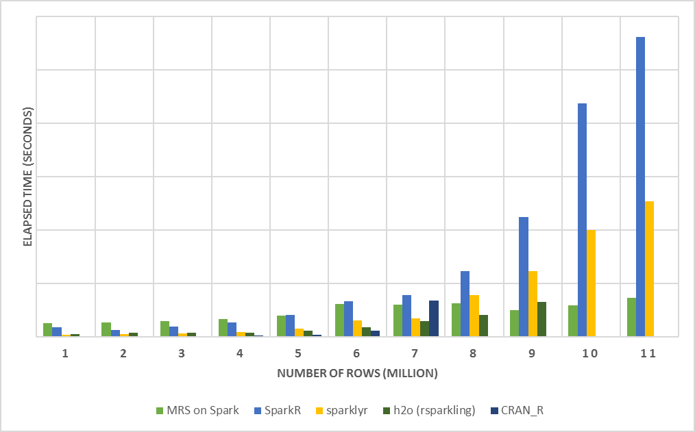
MRS - faster when fitting big data
Configuration:
1 Edge Node: 16 cores, 112GB
4 Worker Nodes: 16 cores, 112GB
Dataset: Duplicated Airlines data (.csv)
Number of columns: 26
37
Notes:
This second plot helps us understand why MRS on Spark is substantially faster than other approaches. As we can easily find out that executing models is a big win of MRS as it takes very small amount of time if the data stores in XDF format.

Slide 38
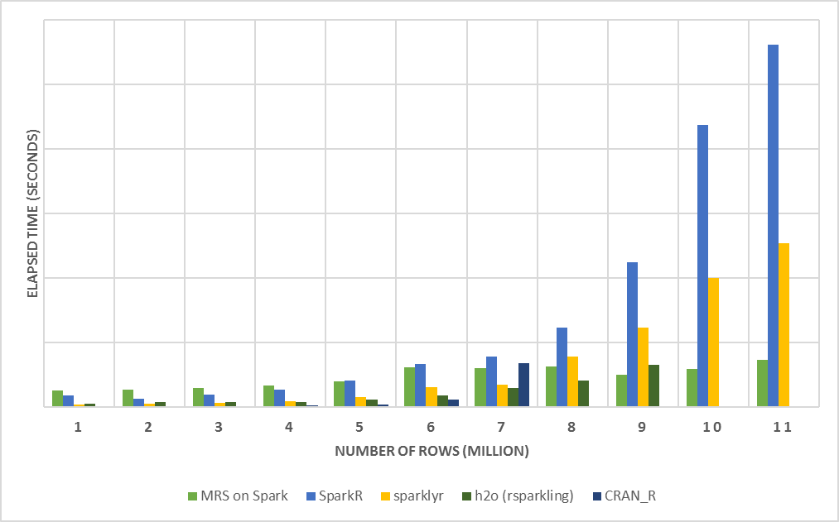
MRS - save time when making predictions
Predict:
Outputs predictions into files in HDFS
Configuration:
1 Edge Node: 16 cores, 112GB
4 Worker Nodes: 16 cores, 112GB
Dataset: Duplicated Airlines data (.csv)
Number of columns: 26
38
Notes:
This second plot helps us understand why MRS on Spark is substantially faster than other approaches. As we can easily find out that executing models is a big win of MRS as it takes very small amount of time if the data stores in XDF format.

Slide 39
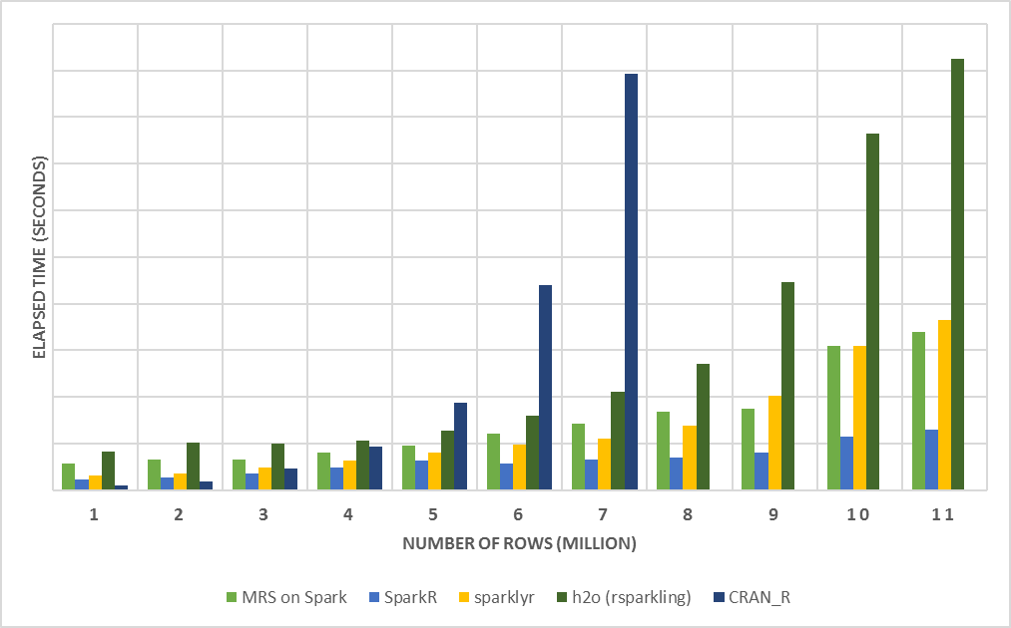
SparkR - outperform when loading data
Load Data:
MRS on Spark: XDF
SparkR: Spark DF
sparklyr: Spark DF
h2o: H2OFrame
CRAN R: DF
Configuration:
1 Edge Node: 16 cores, 112GB
4 Worker Nodes: 16 cores, 112GB
Dataset: Duplicated Airlines data (.csv)
Number of columns: 26
39
Notes:
This second plot helps us understand why MRS on Spark is substantially faster than other approaches. As we can easily find out that executing models is a big win of MRS as it takes very small amount of time if the data stores in XDF format.

Slide 40
Other Options for Scaling R Scripts
Katherine Zhao
40

Slide 41
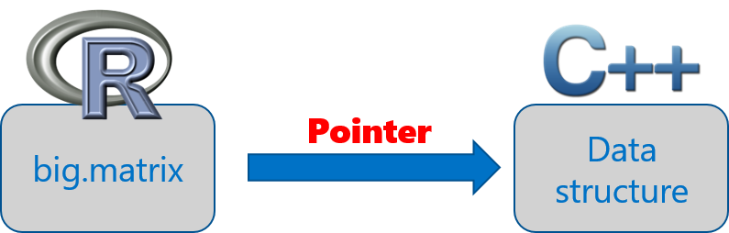
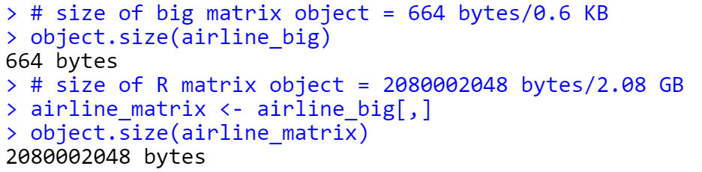
The bigmemory project
bigmemory works with massive matrix-like objects in R
Combines memory and file-backed data structures
Imports a 20 million rows * 26 columns numerical matrix and big.matrix object is much smaller than its corresponding R matrix
Source: “The Bigmemory Project” by Michael Kane and John Emerson: April 29, 2010.
41
Notes:
The bigmemory project was coined by Michael Kane and John Emerson at Yale university.
It was aiming to work with massive matrix-like objects in R. It combines memory and file-backed data structures and creates a big.matrix object.
So, the big.matrix object is a pointer to the core data structures written in C++. It allows users to easily manage and analyze data sets larger than available RAM.
This data structures may also be allocated to shared memory that allow separate processes on the same machine to share access to a data set.

Slide 42
sister packages and related work
biganalytics: provides exploratory data analysis functionality on big.matrix
bigtabulate: adds table-, tapply-, and split-like behavior for big.matrix
bigalgebra: performs linear algebra calculations on big.matrix and R matrix
synchronicity: supports synchronization and may eventually support interprocess communication (ipc) and message passing
biglm: provides linear and generalized linear models on big.matrix
Rdsm: enables shared-memory parallelism with big.matrix
Source: “The Bigmemory Project” by Michael Kane and John Emerson: April 29, 2010.
42
Notes:
The bigmemory package is the core of this project, which also contains a set of sister packages to extend the analytics and other functionalities.
Other packages also use the big.matrix as their data structures to build linear and glm models, such as the “biglm” package or enable shared-memory parallelism, such as “Rdsm”.

Slide 43
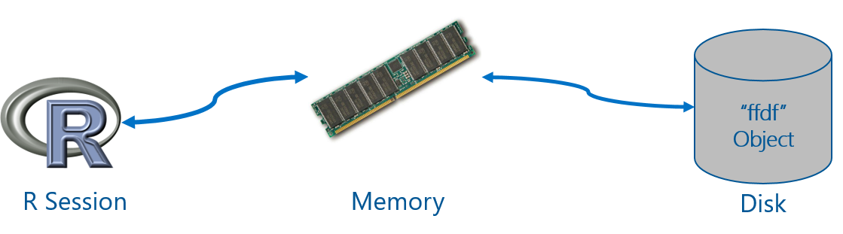
ff package
Provides data structures that are stored on Disk, but behave as if they were in RAM
Maps only a section in main memory for effective consumption
Accepts numeric and characters as input data
Source: ff: memory-efficient storage of large data on disk and fast access functions.
43
Notes:
ff is another package can help R scale on single machines.
It was designed to provide convenient access to large data from persistent storage.
In the storage, ff objects store the raw data in native binary flat files.
Only one small section of the data (typically 4 - 64KB) is mirrored into main memory at a time for effective consumption.
Unlike the bigmemory, ff accepts both numeric and characters data as the input.

Slide 44
ff related packages
ffbase: adds basic statistical functionality to ff. (Note: *.ff apply on ff vectors, and *.ffdf apply on ffdf.)
Coercions: as.character.ff(), as.Date_ff_vector(), as.ffdf.ffdf(), as.ram.ffdf()
Selections: subset.ffdf(), ffwhich(), transform.ffdf(), within.ffdf(), with.ffdf()
Aggregations: quantile.ff(), hist.ff(), sum.ff(), mean.ff(), range.ff(), tabulate.ff()
Algorithms: bigglm.ffdf()
biglars: provides least-angle regression, lasso and stepwise regression on ff.
Source: CRAN Task View: High-Performance and Parallel Computing with R, by Dirk Eddelbuettel.
44
Notes:
Ff package also raises some related work.
ffbase extends ff with some basic statistical functionality. It provides data coercions, selections and aggregations. It also leverages the glm models from the bigmemory project.
Biglars provides least-angle regression, lasso and stepwise regression on ff.

Slide 45
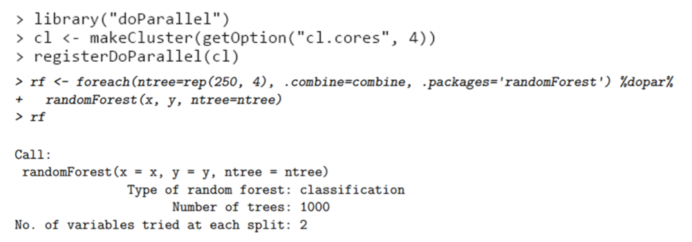
Parallel programming with foreach
Provides a function foreach and two operators %do% and %dopar% that support parallel execution
%dopar% operator relies on a pre-registered parallel backend – doParallel(parallel), doSNOW(snow), doMC(multicore) , doMPI(Rmpi)and etc.
Source: foreach package.
45

Slide 46
Q & A
CONTACT INFORMATION
Vanja Paunic (vanja.paunic@microsoft.com)
Robert Horton (rhorton@microsoft.com)
Hang Zhang (hangzh@microsoft.com)
Srini Kumar (srini.kumar.private@gmail.com)
Mengyue (Katherine) Zhao (mez@microsoft.com)
John-Mark Agosta (joagosta@microsoft.com)
Mario Inchiosa (marioinc@yahoo.com)
Debraj GuhaThakurta (deguhath@microsoft.com)
46

Slide 47
THANK YOU

